Slide 1
Big Mountain Resort
Pricing Recommendations

Slide 2
Problem Identification
How can Big Mountain Resort maximize pricing relative to other resorts based on key features to offset the increased operating costs of $1.54M for a newly added chairlift and increase profitability by at least 5% for this coming season?

Slide 3
Recommendation & Key Findings
Current pricing & as-is recommendation
Current pricing: $81.00 / ticket
Model recommended price: $95.87 / ticket with a mean absolute error of $10.39
Additional recommendations
Close 1 run immediately w/o any effect on pricing. Dependent on operating costs, close 5 total runs & reduce price by $.70 or 8 total runs and reduce price by $1.40 if operating costs for said runs total more than $1.2M or $2.4M respectively.
Add 1 run, increasing the vertical drop by 150 feet, and install an additional chair lift. This would justify an increase in ticket price by an additional $1.99. Over the season, this could be expected to add an approximate $3.5M to annual revenue.

Slide 4
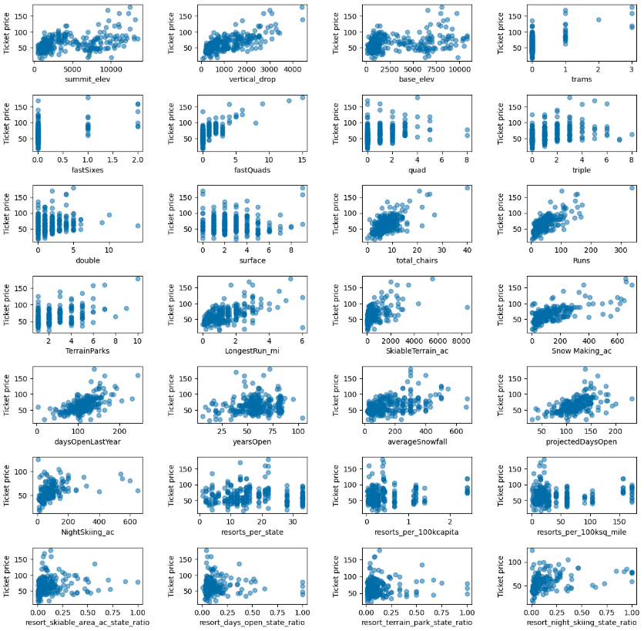
Modeling Results & Analysis - Current Pricing
Strong positive correlations were found between resort features and price so a random forest model was developed, trained, and tested on the resort data received.
Runs, vertical drop, snow making, total chairs, & fast quads had the strongest positive correlation & was confirmed by the model.
The model produced an expected price of $95.87 with a mean absolute error of $10.39, confirming our hypothesis that Big Mountain’s pricing is too low given the features of Big Mountain Resort.

Slide 5
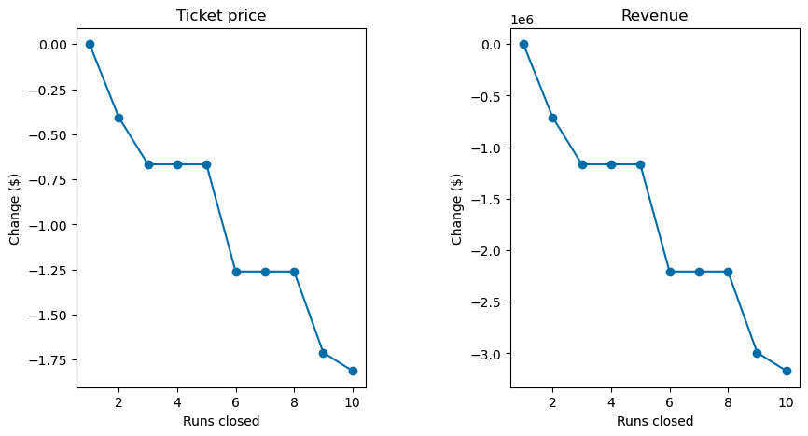
Modeling Results & Analysis - Additional Scenarios
Scenario 1: Close up to 10 of the least used runs.
Closing 1 run had no effect on price
Closing 2 and 3 runs respectively would reduce expected ticket price, but closing 3-5 runs had the same effect on price.
Closing 6 runs would reduce expected price further but had the same effect as closing 6-8 runs.
Operating costs were not part of the received resort data so further analysis is needed to determine the optimal course of action.

Slide 6
Modeling Results & Analysis - Additional Scenarios
Scenario 2: Adding a run, increasing the vertical drop by 150 feet, and installing an additional chair lift.
Model showed an expected ticket price increase of $1.99 / ticket, an approximate $3.5M increase in annual revenue
Scenario 3: Same as Scenario 2 but adding 2 acres of snow making.
Model showed no additional increase in price from scenario 2.
Scenario 4: Increase the longest run by .2 miles and guaranteeing its snow coverage by adding 4 acres of snow making capability.
Model showed no change in price given these changes

Slide 7
Summary & Conclusion
Big Mountain Resort’s ticket price was found to be too low given the resort features
Ticket price should be increased to $95-$96 / ticket
1 run should be closed immediately
Operating costs should be assessed to determine if 5 or 8 total runs should be closed
Close said runs if their operating costs exceed $1.2M & $2.4 respectively and reduce ticket price by $.70 or $1.40 respectively if these changes are made
Add 1 run, increasing vertical drop by 150 ft, & install an additional chairlift
Increase price by $1.99 if these changes are made
Do not move forward with scenarios 3 & 4
Model has been saved and is readily accessible to analyse future proposed feature changes and their effects on pricing

